Slide 1

IE 260 – ENGINEERING ECONOMY Chapter 6 Comparison and Selecting among Alternatives
U. MAHİR YILDIRIM

Slide 2
Chapter 6
Our aim in Chapter 6 is to compare capital investment alternatives when the time value of money is a key influence.

Slide 3

Introduction
Most engineering projects can be accomplished by more than one feasible design alternative.
When the selection of one of these alternatives excludes the choice of any of the others, the alternatives are called mutually exclusive.

Slide 4
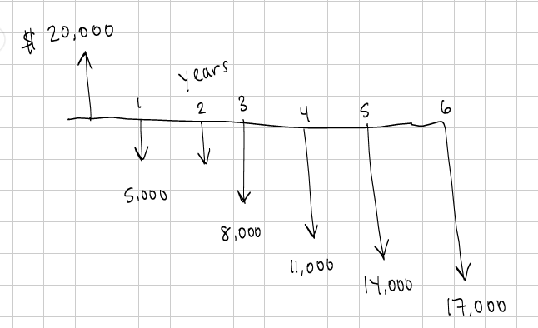
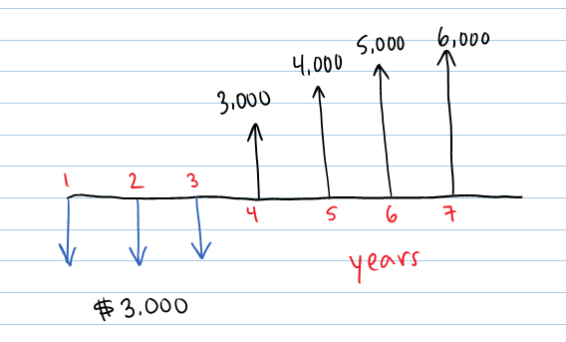
Introduction (cont’d)
Typically, the alternatives being considered require the investment of different amounts of capital, and their annual revenues and costs may vary.

Slide 5
Introduction (cont’d)
Sometimes the alternatives may have different useful lives. The fundamental question is “do the added benefits from a more-expensive alternative bring a positive return relative to the added costs?”
The alternatives must provide comparable “usefulness”:
performance, quality, etc.
The basic methods from chapter 5 provide the basis for economic comparison of the alternatives
PW, FW, AW, IRR

Slide 6
Basic Concepts for Comparing Alternatives
In practice, there are usually a limited number of feasible alternatives to consider for an engineering project.
The alternative that requires the minimum investment of capital and produces satisfactory functional results will be chosen unless the incremental capital associated with an alternative having a larger investment can be justified with respect to its incremental benefits.

Slide 7


Basic Concepts for Comparing Alternatives Base Alternative
We consider the acceptable alternative that requires the least investment of capital to be the base alternative
BASE ALTERNATIVE
investment required by the 1st alternative
investment required by the 2nd alternative
investment required by the 3rd alternative

Slide 8

Basic Concepts for Comparing Alternatives Base Alternative (cont'd)
results
increased capacity
increased quality
increased revenues
decreased operating expenses, or
İncreased life
+
The investment required by the base alternative
The investment of additional capital over that required by the base alternative

Slide 9

Basic Concepts for Comparing Alternatives Decision
In summary, if the extra benefits obtained by investing additional capital are better than those that could be obtained from investment of the same capital elsewhere in the company at the MARR, the investment should be made.

Slide 10
Investment and Cost Alternatives
Select the alternative that gives you the most money!
Investment Alternatives
Cost Alternatives
Cost alternatives are those with all negative cash flows, except for a possible positive cash-flow element from disposal of assets at the end of the project’s useful life
Recall corporate jet example from last week

Slide 11
Investment and Cost Alternatives (cont'd)
Investment Alternative
Cost Alternative
 | Alternative
 | A | B
Capital investment | - 120,000 ₺ | - 150,000 ₺
Annual revenues less expenses | 35,000 ₺ | 30,000 ₺
 | Alternative
End of Year | A | B
0 | - 240,000 ₺ | - 310,000 ₺
1 | - 15,000 ₺ | - 20,000 ₺
2 | - 17,000 ₺ | - 20,000 ₺
3 | - 19,000 ₺ | - 20,000 ₺
A or B ?
A or B ?

Slide 12
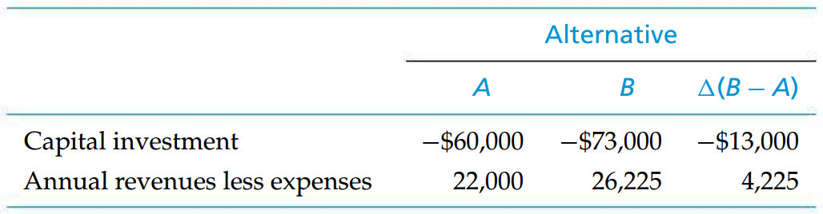
Example Investment Alternatives
Alternatives A and B are two mutually exclusive investment alternatives with estimated net cash flows.
The useful life of each alternative is four years.
MARR = 10%
Base alternative ?
Base alternative
Do the added benefits from a more-expensive alternative bring a positive return relative to the added costs?

Slide 13
Solution Investment Alternatives
PW(10%)_{A} = -$60,000 + $22,000(P/A, 10%, 4) = $9,738,
PW(10%)_{B} = -$73,000 + $26,225(P/A, 10%, 4) = $10,131
In this case, Alternative B is preferred to A because it has a greater PW value.
Hence, the extra benefits obtained by investing the additional $13,000 of capital in B have a PW of $10,131 - $9,738 = $393. That is,
PW(10%)Diff = -$13,000 + $4,225(P/A, 10%, 4) = $393,
and the additional capital invested in B is justified

Slide 14
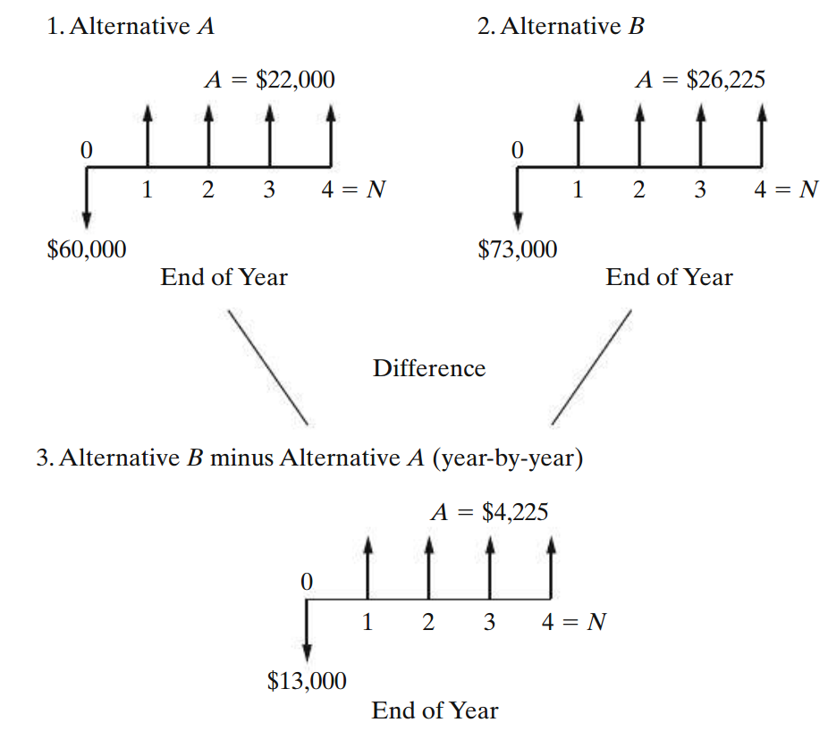
Solution (cont’d) Investment Alternatives
Cash-Flow Diagrams for Alternatives A and B and Their Difference

Slide 15
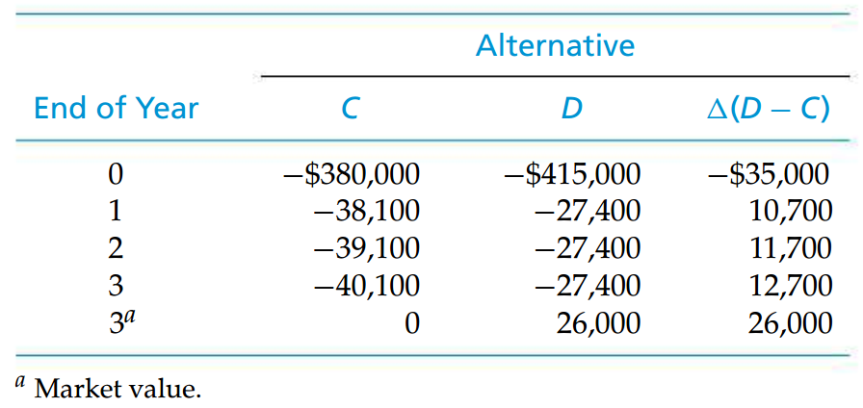
Example Cost Alternatives
Alternatives C and D are two mutually exclusive cost alternatives with estimated net cash flows, as shown, over a three-year life.
Base alternative
With the greater capital investment, Alternative D in this illustration has smaller annual expenses

Slide 16
Solution Cost Alternatives
PW(10%)_{C} = - $477,077
PW(10%)_{D} = - $463,607
Alternative D is preferred to C because it has the less negative PW (minimizes costs)

Slide 17
Solution (cont'd) Cost Alternatives
What is the PW of the additional $35,000 of capital in Alternative D ?
-$463,607 - (-$477,077) = $13,470.
That is, the PW(10%)_{Diff} = $13,470, and the additional capital invested in Alternative D is justified

Slide 18
Ensuring a Comparable Basis
Differences among the alternatives may occur in many forms.
Operational performance factors such as output capacity, speed, thrust, heat dissipation rate, reliability, fuel efficiency, setup time, and so on
Quality factors such as the number of defect-free (nondefective) units produced per period or the percentage of defective units (reject rate)
Useful life, capital investment required, revenue changes, various annual expenses or cost savings, and so on

Slide 19
Ensuring a Comparable Basis (cont’d)
Rule 1: When revenues and other economic benefits are present and vary among the alternatives, choose the alternative that maximizes overall profitability. That is, select the alternative that has the greatest positive equivalent worth at i = MARR and satisfies all project requirements.
Rule 2: When revenues and other economic benefits are not present or are constant among the alternatives, consider only the costs and select the alternative that minimizes total cost. That is, select the alternative that has the least negative equivalent worth at i = MARR and satisfies all project requirements.

Slide 20

The Study (Analysis) Period
Planning horizon
Selected time period over which mutually exclusive alternatives are compared.
The useful lives of alternatives being compared, relative to the selected study period, can involve two situations:
Useful lives are the same for all alternatives and equal to the study period.
Useful lives are unequal among the alternatives, and at least one does not match the study period.

Slide 21
Useful Lives Are Equal to the Study Period
When the useful life of an alternative is equal to the selected study period, adjustments to the cash flows are not required.
Equivalent-worth methods (PW, FW and AW) and rate-of-return methods

Slide 22
Example Equivalent-Worth Methods
Best Flight, Inc., is considering three mutually exclusive alternatives for implementing an automated passenger check-in counter at its hub airport. Each alternative meets the same service requirements, but differences in capital investment amounts and benefits (cost savings) exist among them. The study period is 10 years, and the useful lives of all three alternatives are also 10 years. Market values of all alternatives are assumed to be zero at the end of their useful lives.
If the airline’s MARR is 10% per year, which alternative should be selected in view of the cash-flow diagrams shown on the next slide ?

Slide 23
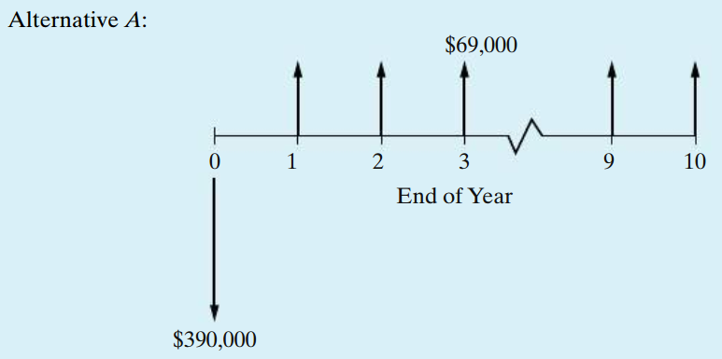
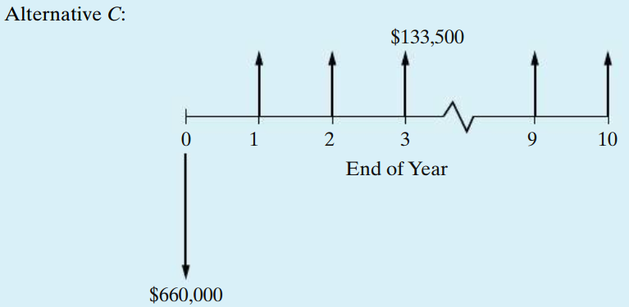
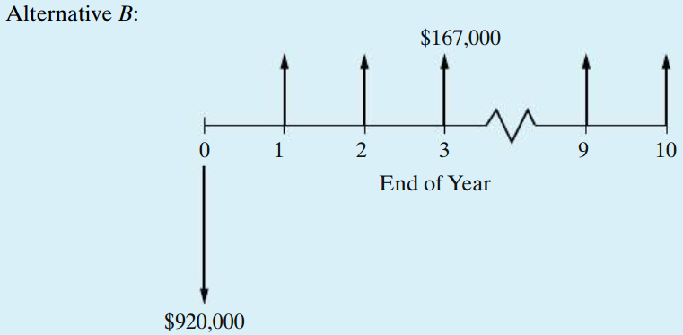
Example (cont’d) Equivalent-Worth Methods

Slide 24
Solution by the PW Method Equivalent-Worth Methods
PW(10%)A = −$390,000 + $69,000(P/A, 10%, 10) = $33,977,
PW(10%)B = −$920,000 + $167,000(P/A, 10%, 10) = $106,148,
PW(10%)C = −$660,000 + $133,500(P/A, 10%, 10) = $160,304
Based on the PW method, Alternative C would be selected because it has the largest PW value ($160,304).
The order of preference is C ≻ B ≻ A, where C ≻ B means C is preferred to B.

Slide 25
Solution by the AW Method Equivalent-Worth Methods
AW(10%)A = −$390,000(A/P, 10%, 10) + $69,000 = $5,547,
AW(10%)B = −$920,000(A/P, 10%, 10) + $167,000 = $17,316,
AW(10%)C = −$660,000(A/P, 10%, 10) + $133,500 = $26,118.
Alternative C is again chosen because it has the largest AW value ($26,118).

Slide 26
Solution by the FW Method Equivalent-Worth Methods
FW(10%)A = −$390,000(F/P, 10%, 10) + $69,000(F/A, 10%, 10) = $88,138,
FW(10%)B = −$920,000(F/P, 10%, 10) + $167,000(F/A, 10%, 10) = $275,342,
FW(10%)C = −$660,000(F/P, 10%, 10) + $133,500(F/A, 10%, 10) = $415,801.
Based on the FW method, the choice is again Alternative C because it has the largest FW value ($415,801).
For all three methods (PW, AW, and FW) in this example, notice that C ≻ B ≻ A because of the equivalency relationship among the methods.

Slide 27
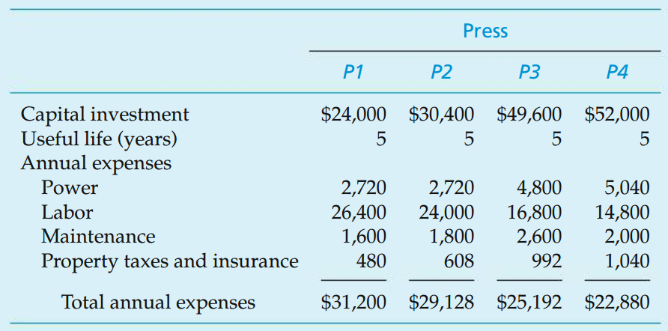
Example Analyzing Cost-Only Alternatives, Using Equivalent Worth
A company is planning to install a new automated plastic-molding press. Four different presses are available. The initial capital investments and annual expenses for these four mutually exclusive alternatives are as follows:
Assume that each press has the same output capacity (120,000 units per year) and has no market value at the end of its useful life; the selected analysis period is five years; and any additional capital invested is expected to earn at least 10% per year. Which press should be chosen if 120,000 nondefective units per year are produced by each press and all units can be sold? The selling price is $0.375 per unit.

Slide 28
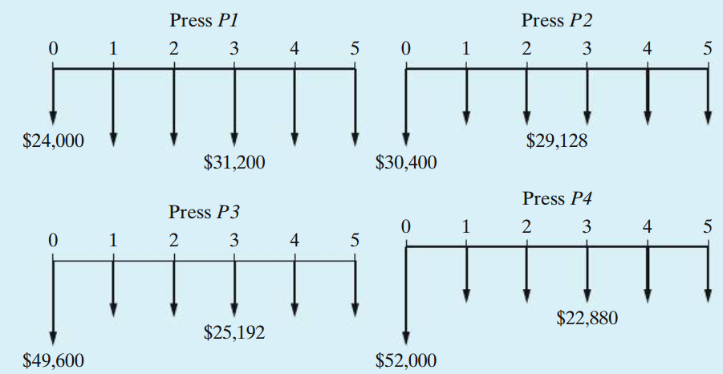
Solution Analyzing Cost-Only Alternatives, Using Equivalent Worth
Since the same number of nondefective units per year will be produced and sold using each press, revenue can be disregarded.

Slide 29
Solution (cont’d) Analyzing Cost-Only Alternatives, Using Equivalent Worth
The PW, AW, and FW calculations for Alternative P1 are
PW(10%)P1 = −$24,000 − $31,200(P/A, 10%, 5) = −$142,273,
AW(10%)P1 = −$24,000(A/P, 10%, 5) − $31,200 = −$37,531,
FW(10%)P1 = −$24,000(F/P, 10%, 5) − $31,200(F/A, 10%, 5) = −$229,131.

Slide 30
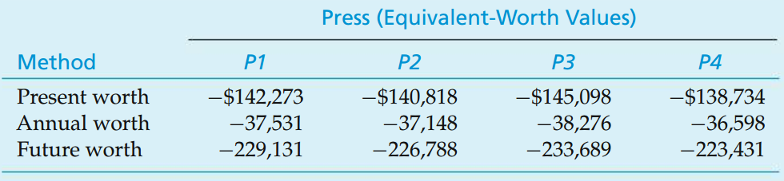
Solution (cont’d) Analyzing Cost-Only Alternatives, Using Equivalent Worth
Alternative P4 minimizes all three equivalent-worth values of total costs and is the preferred alternative. The preference ranking (P4 ≻ P2 ≻ P1 ≻ P3) resulting from the analysis is the same for all three methods.

Slide 31
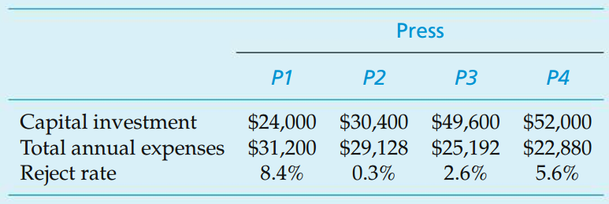
Example Analyzing Alternatives with Different Reject Rates
Consider the four plastic molding presses of the previous example.
Suppose that each press is still capable of producing 120,000 total units per year.
What if the estimated reject rate is different for each alternative ?

Slide 32
Solution Analyzing Alternatives with Different Reject Rates
In this example, each of the four alternative presses produces 120,000 units per year, but they have different estimated reject rates. Therefore, the number of nondefective output units produced and sold per year, as well as the annual revenues received by the company, varies among the alternatives. But the annual expenses are assumed to be unaffected by the reject rates.
In this situation, the preferred alternative will maximize overall profitability. That is, the four presses need to be compared as investment alternatives.

Slide 33
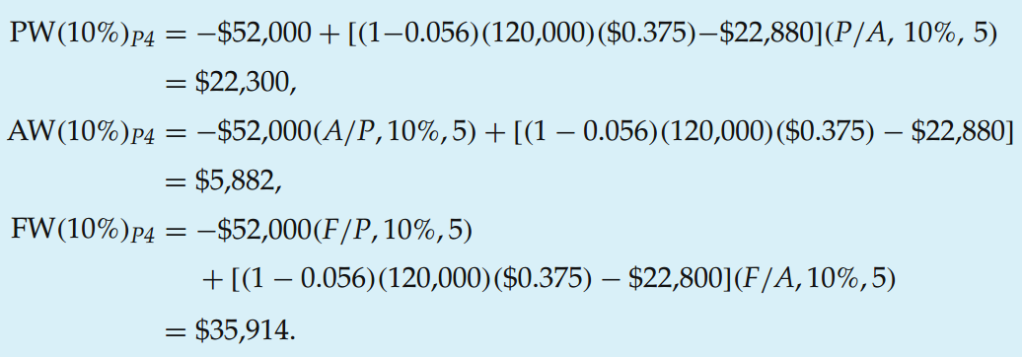
Solution (cont'd) Analyzing Alternatives with Different Reject Rates
The PW, AW, and FW calculations for Alternative P4 ;

Slide 34
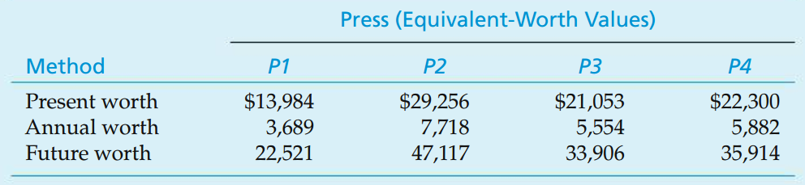
Solution (cont'd) Analyzing Alternatives with Different Reject Rates
The PW, AW, and FW values for Alternatives P1, P2, and P3 are determined with similar calculations
The preference ranking (P2 ≻ P4 ≻ P3 ≻ P1) is the same for the three methods but is different from the ranking in the previous example

Slide 35
Example
Three equal-service machines need to be evaluated economically. Perform the present worth analysis with the costs shown below. Which alternative would you choose? (MARR = 10% per year)
 | A | B | C
Initial Cost, $ | -4,500 | -3,500 | -6,000
Annual operating cost, $/year | -900 | -700 | -50
Salvage value S, $ | 200 | 350 | 100
Life, years | 8 | 8 | 8

Slide 36
Solution
These are cost alternatives. The salvage values are considered a “negative” cost, so a + sign precedes them. (If it costs money to dispose of an asset, the estimated disposal cost has a – sign.) The PW of each machine is calculated at i = 10% for n = 8 years.
PW_{A} = -4,500 - 900(P/A,10%,8) + 200(P/F,10%,8) = $ -9,208 PW_{B} = -3,500 - 700(P/A,10%,8) + 350(P/F,10%,8) = $ -7,071 PW_{C} = -6,000 - 50(P/A,10%,8) + 100(P/F,10%,8) = $ -6,220
Machine C is selected since the PW of its costs is the lowest; it has the numerically largest PW value.

Slide 37
Recall
The basic methods from chapter 5 provide the basis for economic comparison of the alternatives
PW,
FW,
AW,
IRR

Slide 38
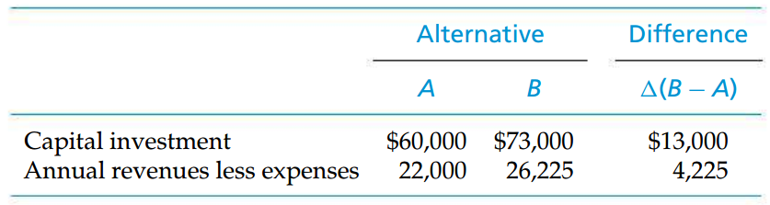
The Inconsistent Ranking Problem
Recall the example;
The useful life of each alternative (and the study period) = 4 years.
MARR = 10%
Calculate the IRR of each alternative.

Slide 39
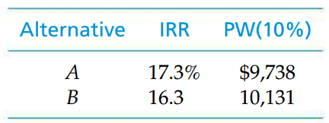
The Inconsistent Ranking Problem (cont’d)
Obviously, here we have an inconsistent ranking of the two mutually exclusive investment alternatives.
MARR = 10%

Slide 40

IRRs of alternatives !
Do not compare the IRRs of mutually exclusive alternatives (or IRRs of the differences between mutually exclusive alternatives) against those of other alternatives.
Compare an IRR only against MARR (IRR ≥ MARR) in determining the acceptability of an alternative.

Slide 41
GOOD LUCK IN THE EXAM…

